Slide 1
Project Plan:
Recipe website

Slide 2
Introduction
This recipe website aims to inspire people to cook at home and to make meal planning easier – the user can search for recipes based on things they have in their fridge or things they’d like to eat, see the ingredients needed and how to make this.
They will be able to save their favourite recipes to make it easier to meal plan.
This can be useful for those on special diets, who want to save money especially in the cost-of-living crisis, want to improve their cooking skills or just want help with organising what to cook for the week.

Slide 3
Key Stakeholders
Customers/end users
  We need to consider the different customer groups e.g. different diets, budgets, time constraints, cooking ability and age groups and the features they would want in the product.
Project sponsor
  This individual is responsible for providing the financial resources for the project and help make the big high-level decisions when issues and conflicting opinions arise
Product owner
  This will be the person who is the ‘face’ of the project – they have raised the requirement for this and help gather the appropriate stakeholders.
Project manager
  They are responsible for managing timelines, budgets and help with chasing up the relevant parties to keep these on track
Solution architect
  They are responsible for the high-level solution design of how it will be built which can include the API’s that will be involved, the data mapping and data bases involved etc

Slide 4
Key Stakeholders
Business analyst
  They are responsible for helping to gather the requirements, analysing them, validating them and turning these user stories which are broken down into acceptance criteria which the developers can build from and the testers can test from. They will be the interface between the development teams and business stakeholders, balancing what is feasible with what the business wants and what the business rules are.
Developers
  They are involved in technical discussions as well as build the solution by writing the code
Testers
  These will test the code is working as expected and they raise any issues with the business analysts and developers
UX designers
  They are responsible for creating wireframes that the developer can build off of, as well as to aid in discussions to validate the design. They also are responsible for making sure the UI/UX design is accessible and user friendly and matches the company’s branding.

Slide 5
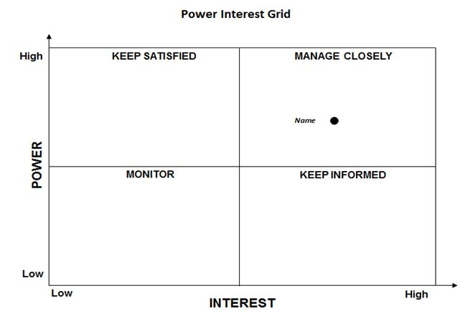

Analysing the stakeholders
Now the stakeholders have been identified, we can analyse them using a stakeholder power/interest grid
These help us categorise our stakeholders into different groups which can guide how we manage them
E.g.
Customers
Project manager
Regulatory e.g. data governance
Product owner
Project sponsor
System admin
Help desk
UX designer
Tester
Developers

Slide 6
Stakeholder Management Plan
Once we have analysed the stakeholders, we can manage them by creating a Stakeholder Management Plan
This will include:
  Name and position/title of stakeholder
  Power/interest grid position
  Known interests and issues
  Current attitude:
    Champion (actively work for success)
    Supporter (in favour but not very active)
    Neutral (no opinion)
    Critic (not in favour, not actively opposed)
    Opponent (actively work to disrupt)
    Blocker (obstruct progress)

Slide 7
Gathering requirements
We need to gather requirements to build the website
These requirements need to consider what the customer and business wants and what is technically feasible
We have received the initial requirement from the Project sponsor who thinks that this is something that customers will want
We will then carry out surveys to get prospective customer feedback on what features would be most desirable to them

Slide 8
Survey
Our survey will be online and we will send this out to participants in the UK, advertised by our social media channels – we will offer a reward to randomly selected participants to encourage people to complete this
Questions include identifying the customer’s age group, how often they cook, how often they would like to cook, barriers to them cooking more, how often they use recipe websites online to cook, how often they use recipes from physical books, any dietary needs they have and if they prefer to cook with recipes that take a specified time/budget
We will leave open questions for suggestions from them on features they would like to see in their website

Slide 9
Focus group
After the results from the surveys have been analysed, we will create several simple wireframes with varying features and we will invite a small pool of participants to take part in a focus group to feedback on how they feel about these features and what could be improved/what features they want to keep

Slide 10
Analysing requirements - Workshop
Once the list of features that are desired by the customers are clearer, we will conduct workshops with people from the business and technical teams to be able to decide the options that are best based on benefits and budget
Process maps and wireframes will be used to visualise and guide these discussions

Slide 11
MOSCOW prioritisation of customer feedback
During this, MOSCOW prioritisation can be used to help guide these discussions of what to keep and what to leave out, or what to have as part of the MVP in the initial launch and what can be put as POST-MVP when there is more budget and time post-launch
Must have: mandatory – min viable product (MVP)/min useable subset
Should have: mandatory – essential for completeness of solution but can be carried forward to the next iteration
Could have: optional - can be developed but not at the expense of must and should items
Want to have: out of scope this iteration/released – parked in backlog (could be promoted to ‘Mus have’ in next release/iteration)

Slide 12
MOSCOW prioritisation results
Must have:
  Can search for recipes using key words such as the name of the dish and ingredients in a dish
  Can see the ingredients and the steps
  Can see a photo of the food
Should have:
  A way for users to log in and save their recipes
  Ability to see how long the recipe takes
Could have:
  A youtube video in the recipe page that describes certain techniques needed in the recipe or the steps from the recipe
  Ability to create a shopping list from the recipe
Want to have:
  Ability to filter search results based on difficulty of recipe, amount of prep work, how long it takes to cook, how many ingredients it needs
  Ability to download the recipe into a pdf
  Ability to create custom named ‘collections’ they can organise their saved recipes to
  Ability to ‘rate’ recipes that users have tried
  Ability for users to add their own recipes
  Ability for users to comment on the recipe page and to upload their own photos of their recreations
  A forum section for users to ask questions and get answers
  Ability to see different conversions e.g. grams, ounces etc
  Ability to scale the recipe for different serving size options

Slide 13
Project Implementation Plan

Slide 14
MVP
Home page
Search for recipes using key words
See a list of relevant results
See the steps for the recipe
See the ingredients for the recipe
See a photo of the recipe

Slide 15
POST-MVP
Pagination of the search results
Shopping list
Filter on difficulty
Search based on ingredients and diet rather than just recipe name
Scale recipe
Convert to different units
Rate recipes
Comment on recipes
Save recipes
View saved recipes page
Log in page

Slide 16
Project Design

Slide 17
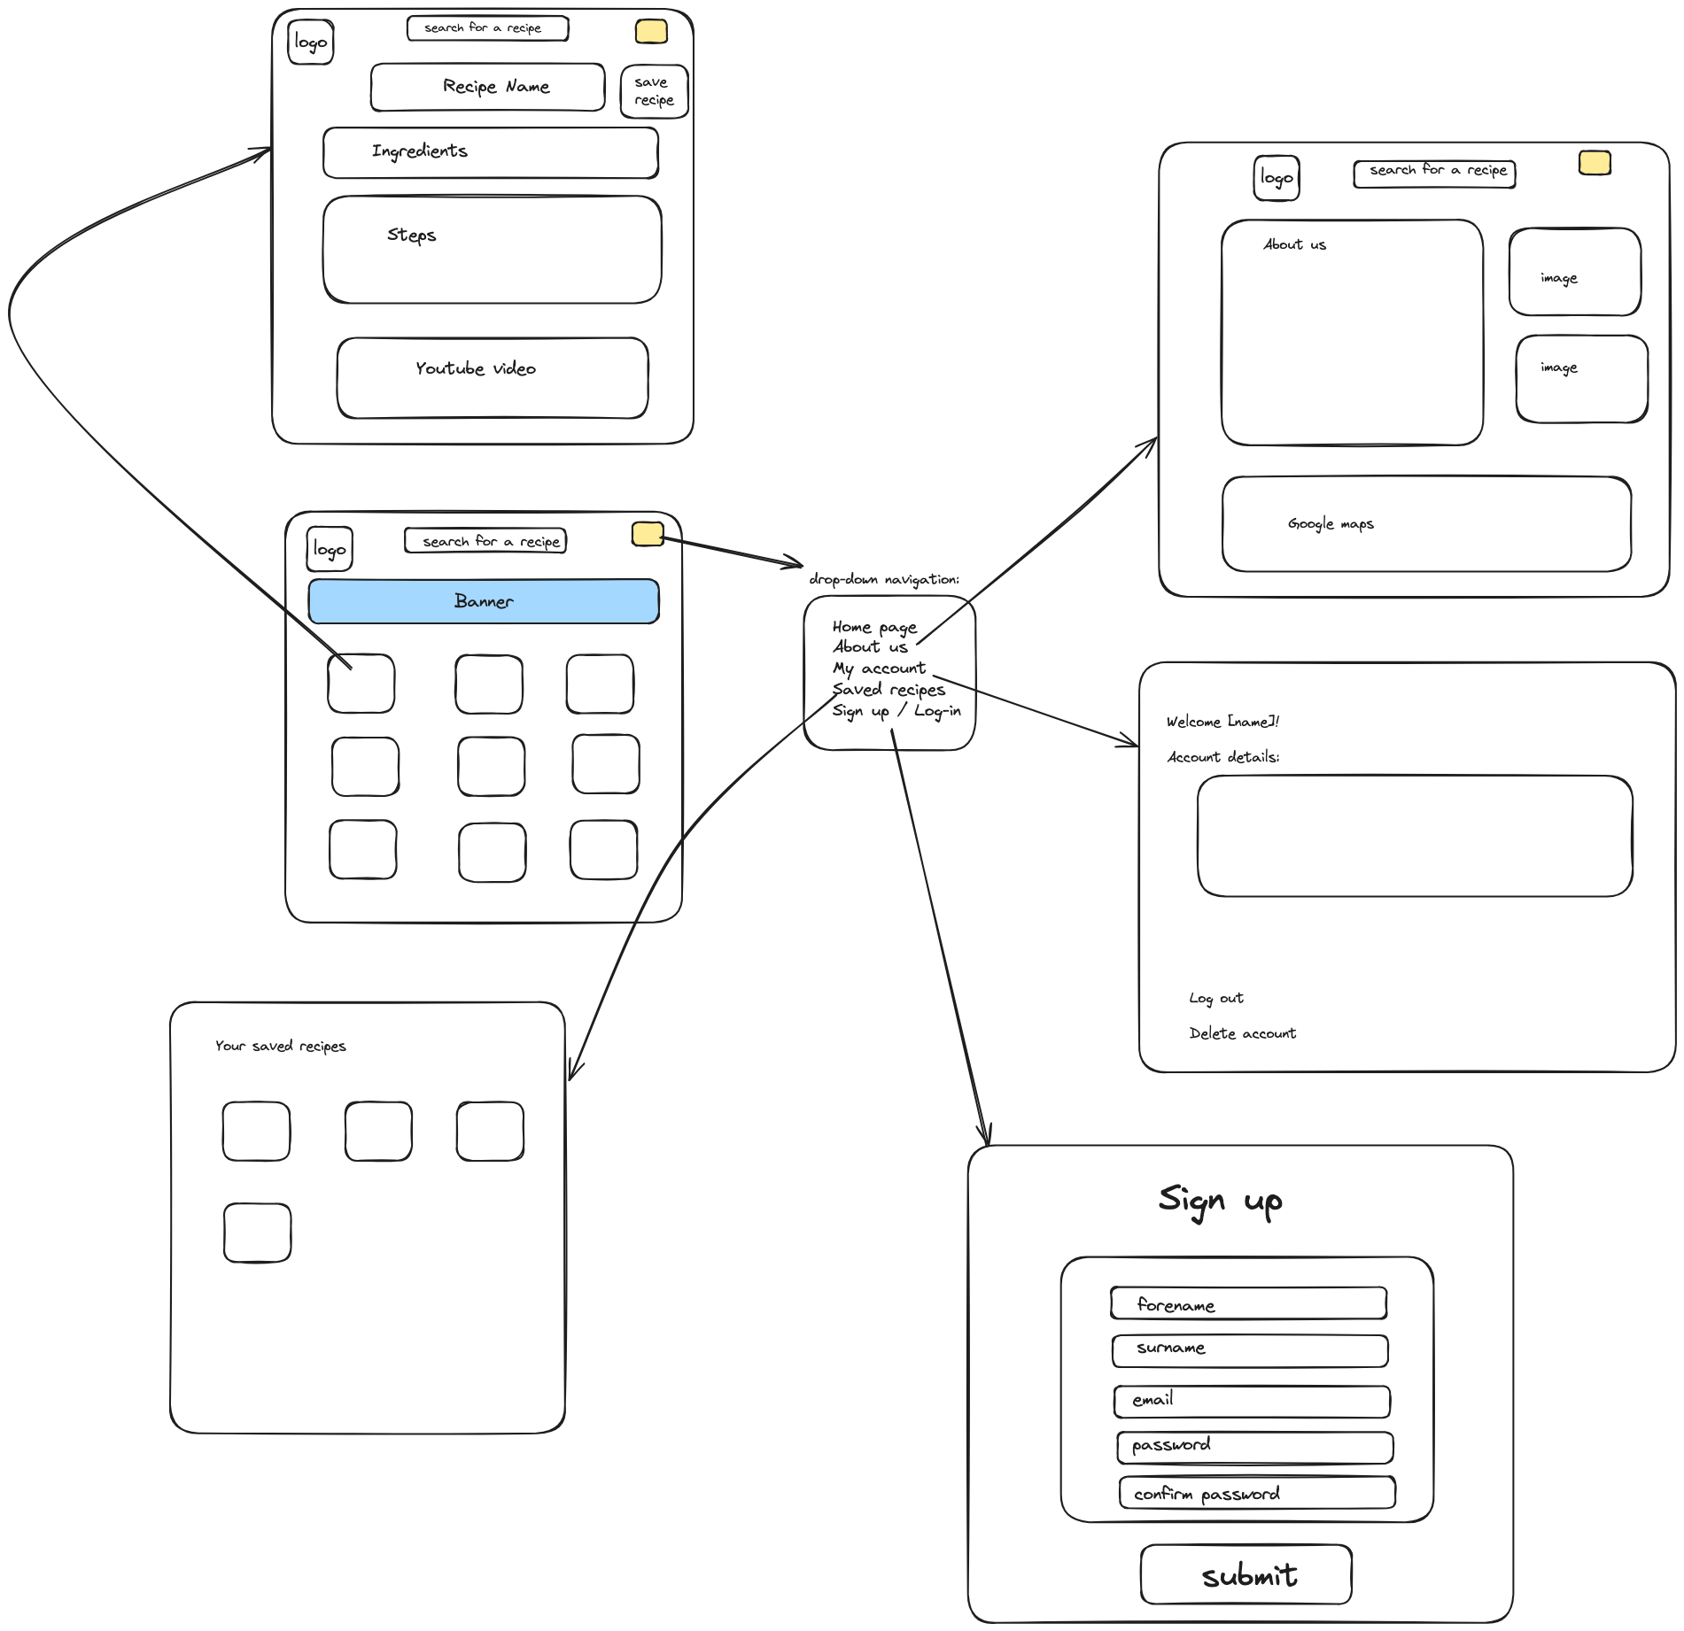
Wireframe
https://excalidraw.com/#json=ngUFVQa_KbQzRt9o7siB7,EhHkcfhe5tA_iR0eB1rzww

Slide 18
MVP delivery

Slide 19
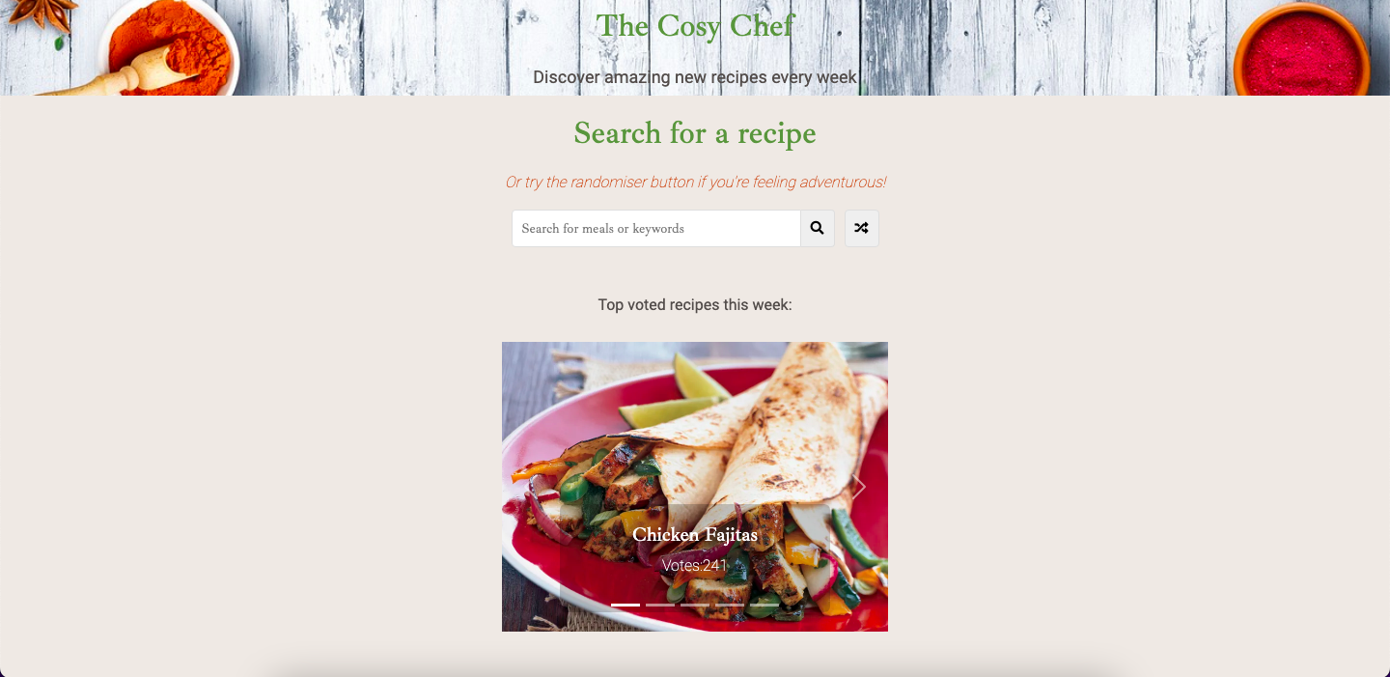
Features
Whole website is a single HTML page that looks like it uses several html files but is actually using Javascript functions to hide/display parts of the page
The user can click on the header at any point which will take them back to the landing page view (i.e. refreshes the page)
On landing there is a carousel made with Boostrap which shows the ‘top recipes of the week’
  This uses a web API made in C# with data I have created
  Clicking on the image takes them to an external recipe link
http://fb03.decoded.com/meal-finder-final/meal-finder-final/

Slide 20
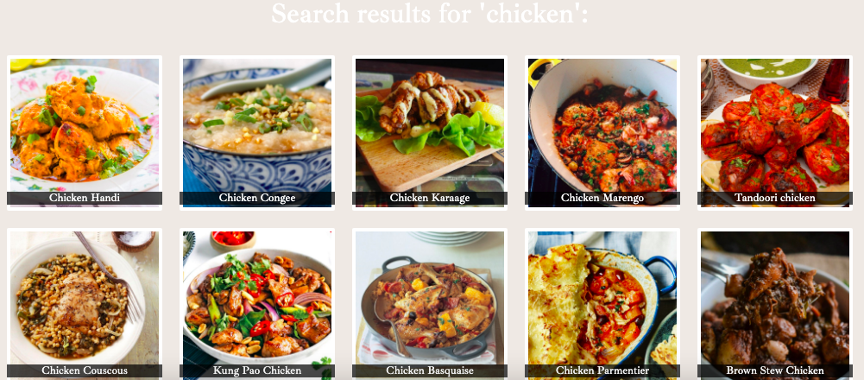
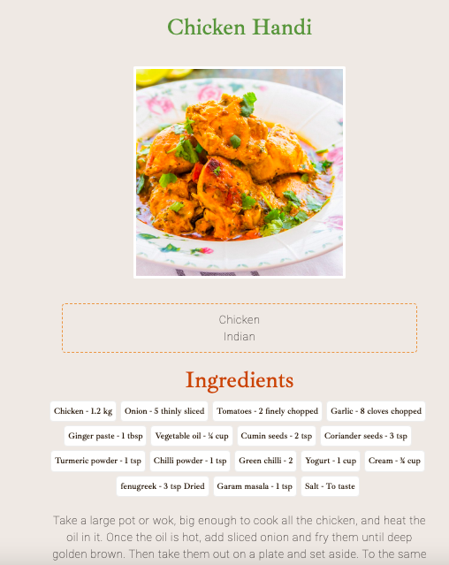
Features
They can search for a recipe in the search bar using a key word that is in the recipe name e.g. ‘chicken’
This returns results using an external API (MealDB API) and puts them in a CSS grid layout
Clicking on the recipe will automatically jump the user down to the recipe at the bottom of the results
They can see the ingredients, measurements and steps

Slide 21
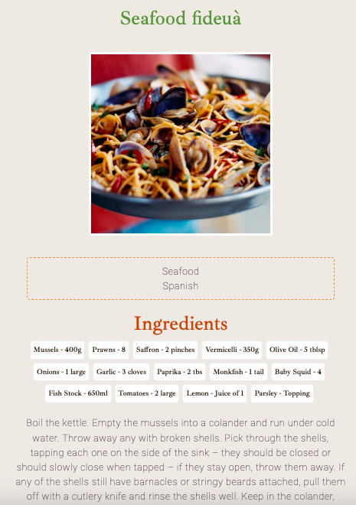
Features
They can also click on the ‘Randomiser’ button which will again call the MealDB API to return a random recipe

